Slide 1
FUTURE DIRECTIONS:
THE BSD HEALTH SURVEY 2019
FORUM
February, 2nd, 2020
Facilitated by Joanne Gurd.

Slide 2

BSDCQ RECORDING

Slide 3
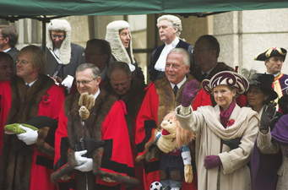
INTRODUCTIONS

Slide 4
AIMS OF THE FUTURE DIRECTIONS
PROJECT
The aim of the BSD health survey 2019 was to obtain data that would allow breeders and breed clubs, and other interested parties, to begin to gauge the health status of the BSD, and to identify the occurrence of any health (and potentially genetic) concerns
The aim of the BSDCQ health forum 2020 is to present the survey outcomes, and to consult with members of the BSDCQ to decide if the club would like to develop health plans and/or other actions to address any identified health concerns

Slide 5
FORUM PLAN
Presentation of BSD Health Survey 2019 outcomes
What are we doing well?
What (if anything) do we want to change?
Where to now?

Slide 6
OTHER AIMS FOR
THE FORUM?

Slide 7
WHAT WOULD A ‘GOOD’ BREED CLUB BE DOING?
The Kennel Club (UK) has estimated that the number of healthy pedigree dogs is very high
Comparatively, pedigree dogs are healthier than the human population which suffers from some 40,000 different types of diseases compared to about 400 in the dog population
Around 90% of pedigree dogs will not suffer from health problems which have a detrimental effect on their quality of life – and that figure is improving thanks to advances in science and the introduction of Disease Surveillance Programmes
Breeding programmes should be undertaken responsibly and with the aim of improving the overall health and wellbeing of the breed. Due consideration must be given to recognised hereditary characteristics in all breeds (ANKC, October, 2013)

Slide 8
WHAT WOULD A ‘GOOD’ BREED CLUB BE DOING?
(ANKC National Code of Practice for Hereditary Diseases, n.d.)
Members will take responsible action to reduce the incidence of hereditary diseases in their breeds
Where a hereditary disease is recognised by the ANKC in consultation with the official breed club(s) to be a designated problem in a breed, and where there is a screening procedure or test for that disease approved by the ANKC:- (a) The owner of a stud dog should, before making the dog available for stud duty -(i) have a current official evaluation or test result for the dog for such hereditary disease: (ii) provide the official evaluation or test result to the owners of the bitch to be mated.(b) The owner of a bitch should, before mating her to a dog -(i) have a current official evaluation or test result for the bitch for such hereditary disease:(ii) provide the official evaluation or test result to the owner of the stud dog
The ANKC recognises that before approving a screening procedure or test for a hereditary disease that procedure should be:-(a) scientifically validated (b) reliable (c) readily available (d) cost effective
Before any puppy or adult animal is sold, the prospective owners should be advised that the seller has taken all reasonable steps to comply with the Code of Practice

Slide 9
WHAT WOULD A ‘GOOD’ BREED CLUB BE DOING?
(Dogs Queensland Canine Health Charter, n.d.)
Educate the members on the problems of hereditary diseases and the means of attacking those problems.
Promote, recommend and monitor control programs to reduce the incidence of hereditary diseases in dogs.
Develop and maintain liaison with the ANKC for coordination of activities and mutual support of initiatives and programs
Advise the Board, Staff and Members on technical/scientific matters relevant to the CCC(Q) Ltd including:
Hereditary Diseases
Canine Research
Health
DNA Testing and Profiling
Other matters as the need arises
Recommend action programs relating to these matters as desirable for the benefit of dogs and resolution of related problems

Slide 10
WHAT WOULD A ‘GOOD’ BREED CLUB BE DOING?
(Australian Canine Eye Scheme Rules and Procedures, January 2008)
By seeking to be placed on an ANKC-approved Open Register for inherited disease surveillance, the National Breed Council for that breed is making a clear statement on behalf of all active breeders and club members
They are saying that optimum health standards are very important, and that while all disease testing is undertaken voluntarily, adherence to a strict policy of disease surveillance is a prerequisite for any serious breeding programme
They realise that by offering all puppy buyers such a transparent commitment to quality assurance, they are expressing a higher degree of confidence in the general health of any puppy purchased from a responsible breeder and breed club member

Slide 11
WHAT WOULD A ‘GOOD’ BREED CLUB BE DOING? (THE KENNEL CLUB, n.d.)
CONTROLLING OR ERADICATING DISEASES
REDUCING ISSUES OF GENETIC DIVERSITY
REDUCING PROBLEMS CAUSED BY CONFORMATION
COMMUNICATING WIDELY WITH BREEDERS AND OWNERS
DELIVERING EDUCATION ON THE BREED
RUNNING HEALTH SCREENING EVENTS AND SCHEMES

Slide 12
WHAT WOULD A ‘GOOD’ BREED CLUB BE DOING? (THE KENNEL CLUB, n.d.)
CONDUCTING HEALTH SURVEYS
PRIORITISING HEALTH ISSUES
PUBLISHING HEALTH SURVEY RESULTS
WORKING WITH GENETIC EXPERTS
PROVIDING ONLINE HEALTH RESOURCES
DEVELOPING HEALTH PLANS

Slide 13
WHAT WOULD A ‘GOOD’ BREED CLUB BE DOING? (THE KENNEL CLUB, n.d.)
APPOINTING A HEALTH COORDINATOR
AND WORKING PARTY
RAISING FUNDS FOR HEALTH PROJECTS
PUBLISHING AN ANNUAL HEALTH REPORT

Slide 14

THE BSD
HEALTH SURVEY

Slide 15

WHY DO A HEALTH SURVEY?

Slide 16
FROM PILOT TO PAPER
A pilot was conducted in early August, 2019
Survey open between August and November, 2019
Web-based survey platform ‘SurveyMonkey’
Electronic and paper versions of the survey form were available but not utilised
Survey advertised by the BSDCQ, Dogs Queensland, and some other State Canine bodies; heavily promoted on breed discussion lists within social media
Survey outcomes analysed in December, 2019 and January, 2020
De-identified statistical data checked by Uni lecturer/veterinary and Emiritus Professor
Draft report completed in January 2020 (available for Forum use only)
Final report and forum video to be loaded onto web site during March, 2020

Slide 17
ADVANTAGES AND LIMITATIONS
OF THE SURVEY DATA
ADVANTAGES
😃 It allowed for a large number of BSD to be surveyed (520)
😃 It was quick! The data was collected and analysed, and the report written within a six - month period
😃 It was cost effective

Slide 18
ADVANTAGES AND LIMITATIONS
OF THE SURVEY DATA
LIMITATIONS
😞 The data represents approximately 10% of BSD bred since the year 2000, so a large number of people did not complete the survey
😞 Some of the questions meant different things to different people eg: Lymphoma was entered as a response in two sections
😞 A number of people did not enter the variety of their BSD, which meant it is difficult to break down the diseases as a function of variety
😞 There were relatively small numbers of Malinois (32) and Laekenois (15) entered, although this may also be related to the previous limitation

Slide 19
THE BSD SURVEY DOGS
Data was submitted for 520 dogs
46% male and 54% female
Ages from a few weeks to 17 years
41% deceased
Majority residing in Australia
27.5% used for breeding purposes - 185 litters of pups - average of six live births per litter.
62% neutered.
76% registered with the Australian National Kennel Council
Notes:
G 179; T 131; M 32; L 15; skipped 163

Slide 20
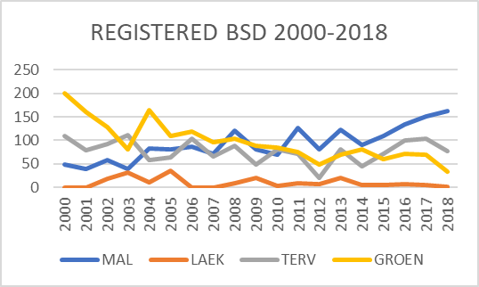

Slide 21
HEALTH/DISEASE
TESTING
35% completed hip and elbow screening (primarily through the Canine Hip and Elbow Dysplasia Scheme (CHEDS) scheme)
Reported scores in the survey for hips ranged from 0:0 to 18:20, and for elbows 0:0 to 0:2
33% of BSD completed at least one eye screen (Australian Canine Eye Scheme - ACES) – 75% normal.
Identified eye disorders in the survey were primarily persistent pupillary membranes (PPM’s) and ‘cataracts’, majority described as posterior polar subcapsular cataract (PPSC)
20 BSD screened by a specialised veterinary cardiologist - 80% showed no auscultatory evidence of cardiac disease; two diagnosed with patent ductus arteriosus (hole in heart)
15% had undertaken DNA testing (primarily Orivet) – with no genetic disorders/diseases identified

Slide 22
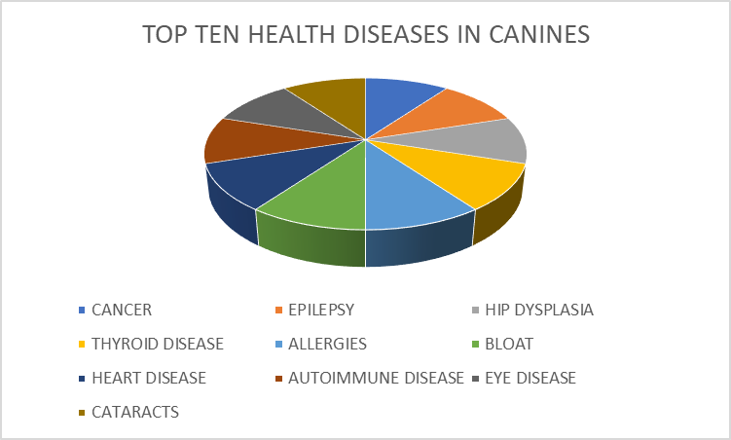
TOP TEN HEALTH DISEASES IN DOGS (Ostrander, 2018).

Slide 23
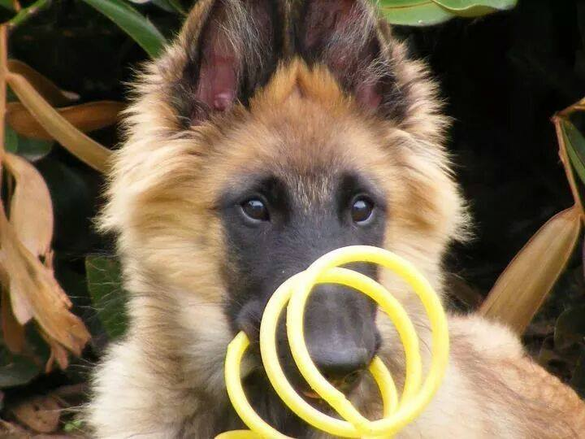
BSD HEALTH SURVEY 2019
OUTCOMES

Slide 24
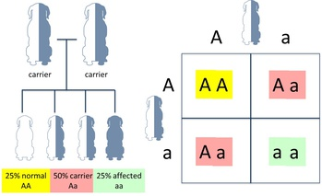
WHAT DO THE FOLLOWING
PERCENTAGES REALLY MEAN?
Many genetic disorders in dogs are caused by single, autosomal recessive mutations

Slide 25
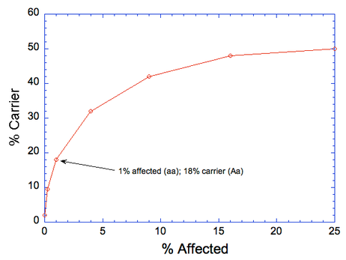
THE HARDY-WEINBERG EQUATION

Slide 26
THE HARDY-WEINBERG EQUATION
When the frequency of affected dogs (aa) in a population is 1% (that's only five dogs in a population of five hundred), the frequency of carriers is almost 20%
When the frequency of affected dogs (aa) in a population is 5% affected, the frequency of carriers is almost 35%
When the frequency of affected dogs (aa) in a population is 10% affected, the frequency of carriers is over 40%
“Go back and scan the last health survey of your breed. Notice any problems that are so uncommon that nobody is worrying about them? The odd PRA here, a case or two of degenerative myelopathy, perhaps a few dogs with cerebellar ataxia or myasthenia gravis, but not in any dogs that you know. Think about this the next time a breeder says of a genetic disorder "Oh, that's not been a problem in our breed." The seeds of the next problem are already sown” (Beauchat, 2014).

Slide 27
HEALTH ISSUES (Over 10%)
Behavioural Issues – 44.62%
Based on C-BARQ criteria
Non-social fears 23.46% e.g. sudden or loud noises; in heavy traffic; in response to strange or unfamiliar objects; during thunderstorms; when first exposed to unfamiliar situations; in response to wind or wind-blown objects
Timidity 11.7%
Separation related behaviours 10.6%
Dog directed aggression 8.3%
Stranger related fear 8.1%
Notes:
G 43 (24%); L 5( 33.3%); M 23 (71.9%); T 36 (27.5%) * 126 missing variety

Slide 28
HEALTH ISSUES (Over 10%)
Behavioural Issues – 44.62%
Dearth of research related to BSD
University of California Davis research re Malinois - the single copy allele of DAT-VNTR has been found to be associated with owner-reported seizures, loss of responsiveness to environmental stimuli, episodic aggression, and hyper-vigilance in the Malinois
Findings should be considered preliminary until replicated in a larger sample (Lit, Belanger, Boehm, Lybarger, & Oberbauer, 2013)
Darwin’s Ark – International study about canine behaviour, genes controlling all sorts of canine traits, from size to coat colour to shyness to interest in play https://darwinsark.org

Slide 29
💡 Canine Behavioural Assessment & Research Questionnaire (C-BARQ)
University of Pennsylvania’s Canine Behavioural Assessment & Research Questionnaire (C-BARQ) is a standardised, behavioural evaluation tool
Originally designed to measure the prevalence and severity of behavioural problems in privately-owned and working dogs
C-BARQ is an invaluable tool for developing and maintaining breed-specific behavioural profiles over time
Can evaluate the behaviour of the offspring of particular sires and dams; monitor the progress of behavioural selection within breeds or lineages over time, obtain reliable phenotypic measures of behaviour for future genetic studies of temperament
https://vetapps.vet.upenn.edu/cbarq

Slide 30
HEALTH ISSUES (Over 10%)
Cryptorchidism – 13.25%
Cryptorchidism stated as one of the most common birth defects (Amann & Veeramachaneni, 2007)
19% of the surveyed male BSD reported as having a disorder of the reproductive system
Almost two thirds of these were suffering from unilateral or bi-lateral cryptorchidism (7.8% Groenendael; 9.4% Malinois; 6.8% Tervueren)
Kennel Club Dog Health Survey (2014), cryptorchidism in 1.79% of Groenendael and 3.41% Tervueren,
Incidence varies in different dog breeds and populations with a reported range of 1–11% (Amann & Veeramachaneni, 2007)
Research not yet available to determine if monogenic or polygenic, however believed to involve more than one gene (Amann & Veeramachaneni, 2007; Romagnoli, 1991)
Other factors include epigenetic and environmental factors (Amann & Veeramachaneni 2007).
Notes:
G 14 (7.8%); L 0; M 3(9.4%); T 9 (6.8%) * 5 missing variety and 7 skipped

Slide 31
HEALTH ISSUES (Over 10%)
Cancer 11.5%
11.5% of BSD diagnosed with cancer
Stomach cancer- 5.6% Groenendael; 3.8% Tervueren
OFA survey - A Belgian Tervuren Health Survey 2014 – Deceased Dogs (2006 - 2014) - 39.9% died from cancer - stomach cancer 10%
Kennel Club Dog Health Survey (2014), cancer in 3.57% of Groenendael and 3.41% of Tervueren .
Seim-Wikse, Jörundsson, and Nødtvedt (2013) – Tervueren 56 times more likely to be diagnosed with gastric carcinoma than the average breed
💡 International Register of Belgian Shepherds with Stomach Cancer
Notes:
G 10 (5.6%) ; T 5 (3.8%); M 0; L 0 *2 missing variety

Slide 32
HEALTH ISSUES (5-9%)
Missing Teeth – 8.65% (7.5)
The BSD should have “strong, white teeth, regularly and strongly set in well-developed jaws. Scissor bite, a pincer bite that is preferred by sheep and livestock herders is tolerated. Complete dentition according to the dental formula. The absence of two premolars 1 (2 P1) is tolerated and the molars 3 (M3) are not taken into consideration” (ANKC, 2014).

Slide 33
HEALTH ISSUES (5-9%)
Missing Teeth – 8.65% (7.5)

Slide 34
HEALTH ISSUES (5-9%)
Missing Teeth – 8.65% (7.5)
Inheritance of missing teeth appears to be complex, with limited research available
Almost 90% of the BSD surveyed had full dentition, with 8.65% reported as having missing teeth
Six cases of missing teeth were related to injury/old age etc… 7.5% related to other causes
Groenendael 11.2%; Tervueren 6.1%
The OFA Disease Database (as of 2018) graded dentition in 6.5% of Groenendael, 8.40% of Tervueren, and 4.76% of Malinois as ‘abnormal’ (OFA, 2018)
The Dentition Database, OFA, USA - established in late 2011
Certifies dogs with all adult teeth fully erupted
Each dog is examined and classified by a licensed veterinarian - determines whether all adult teeth are fully erupted, identify any persistent (retained) deciduous teeth, as well as any missing teeth
💡 The Dentition Database Exam Form
Notes:
- G 20 (11.2%); L 0; M 0; T 8 (6.1%) * 11 missing variety

Slide 35
HEALTH ISSUES (5-9%)
Skin Disorders – 8.27%
Groenendael 7.8%; Malinois 9.4%; Tervueren 7.6%
Majority reported as unknown causes (just under 33%)
Food sensitivity (just under 14%)
Flea sensitivity (just under 12%)
Kennel Club Dog Health Survey (2014) noted Groenendael and Tervueren as experiencing hypersensitivity skin disorders of 7.14% and 2.27%, and chronic itching 1.79% and 1.14%
Notes:
G 14 (7.8%); L 0; M 3 (9.4%); T 10 (7.6%) *16 missing variety

Slide 36
HEALTH ISSUES (5-9%)
Seizures – 5.6 %
Just over 10% of surveyed BSD’s had experienced nervous system conditions
Over half of this percentage was seizure related (6.1% Groenendael; 3% Tervueren, 13.3% Laekenois)
28% of these BSD were reported as being diagnosed by a veterinary as suffering from idiopathic epilepsy (Groenendael and Tervueren)
Kennel Club Dog Health Survey (2014) reported seizures in 5.45% of Groenendael and 5.7% of Tervueren
OFA survey of 581 Groenendael’s (n.d.) 6.4% had been diagnosed with idiopathic epilepsy, and 2.4% with occasional/random seizures
Gullov, Toft and Berendt (2012) stated “Belgian shepherds suffer from focal genetic epilepsy. The prevalence of epilepsy has been estimated to 9.5% in the breed” (p. 1115).
Notes:
G 11 (6.1%); L 2; M 0; T 4 (3%) *12 missing variety

Slide 37
HEALTH ISSUES (5-9%)
Seizures – 5.6 %
Seizures reported in nearly all breeds of dogs - typically considered to be 0.5% - 5% but can be much higher within a single breed
Research supports a hereditary basis for idiopathic epilepsy, with a variety of genetic inheritance models proposed
In the Tervueren and Groenendael described as being highly heritable with a polygenic mode of inheritance, though influenced by a single autosomal recessive locus of large effect (Oberbauer, Grossman, Irion, Schaffer, Eggleston, & Famula, 2003)
In 2012 - a new epilepsy gene for idiopathic epilepsy in the tervueren was found in the canine chromosome 37 (Seppälä, et al. 2012)
Waiting for a DNA test for epilepsy in the Tervueren - permit breeders to undertake selective breeding and assist in reducing the frequency
💡 The International Epilepsy Register

Slide 38
HEALTH ISSUES (2 - 5%)

Slide 39
HEALTH ISSUES (1% to 2%)

Slide 40
HEALTH ISSUES COMMENT
Data failed to capture at least one highly significant issue: In comparing elbow scores in the survey with the elbow scores reported within the CHEDS where it was recorded on the 20.01.2020 that 42.31% of Malinois and18.8% of Groenendael were graded as ‘abnormal’
This is likely due to the potentially small number of Malinois entered into the survey (only 1/32 Malinois reported as having been diagnosed with elbow dysplasia)
(Live elbow scores updated daily for dogs x-rayed in the last five years only. Retrieved from http://orchid.ankc.org.au/Home/ElbowScores)

Slide 41
HEALTH ISSUES COMMENT
Australian breeder’s web database outcomes

Slide 42
MORTALITY
Almost 41% of the BSD were reported as no longer living at the time of the survey
Average age of death/euthanasia was 9.3 years
The youngest to die was aged four weeks - longest reported lifespans were 17 years
Most frequently indicated cause of death was old age, or complications of old age (42%), cancer (25%), snake bites (just under 6%)
Outcomes of the Kennel Club Dog Health Survey, 2014 - cause of death of 43 BSD’s was cancer, gastric cancer, old age, and osteopathy

Slide 43


Slide 44
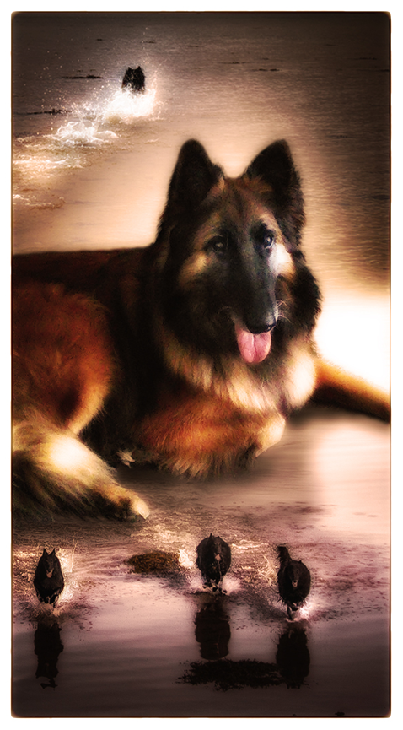
CELEBRATING WHAT WE ARE
DOING WELL

Slide 45


Slide 46
BSD
HEALTH CONCERNS
💡

Slide 47
GENERIC ILLNESS SEVERITY INDEX FOR DOGS (GISID, 2009)

Slide 48


Slide 49
SMALL GROUP
FEEDBACK

Slide 50
DO WE NEED A
BREED HEALTH PLAN/S?
“Don’t waste your time and effort trying to persuade the people who don’t want to get involved. It’s like mud-wrestling with a pig; you both get dirty, but the pig enjoys it”.
There are some important lessons about how to get started, or how to accelerate what you’re already doing:
If you wait to develop the “perfect plan”, you will wait a very long time
If you wait to get “everyone on board”, you will wait a very long time
Find some “early supporters” who want to work with you to improve things
Have a go; see what works, then refine it and extend it
(The Kennel Club, n.d.)

Slide 51
EXAMPLE ONE:
OVERALL BREED HEALTH PLAN
Introduction
Summarise the purpose of the Breed Health Plan, how it was created and how it should be used
History of the Breed
Describe its origin and function
Explain how its appearance relates to its function
Describe its temperament and behavioural characteristics
Summarise the registration statistics for the past 10 years

Slide 52
EXAMPLE ONE:
OVERALL BREED HEALTH PLAN
Breed Health
Summarise data from Health Surveys to identify the most significant health problems that affect that breed.*
Explain any concerns related to the conformation of the breed and how these affect its health.
Summarise data related to genetic diversity of the breed.
Objectives and Plans
List the specific objectives for addressing any concerns described in the “Breed Health” section.
Explain the plans that are in place to achieve the objectives.
* Could this involve further disease specific surveys?

Slide 53
EXAMPLE ONE:
OVERALL BREED HEALTH PLAN
Breeding Recommendations
Summarise the recommendations for anyone breeding puppies. This might include details of screening programmes, advice on Coefficients of Inbreeding, limits on numbers of litters etc.
Breed-specific Judging Guidance
Explain the aspects of the breed that judges are expected to take account of at conformation shows (or other events), together with actions they are expected to take to Protect the health of the breed

Slide 54
EXAMPLE ONE:
OVERALL BREED HEALTH PLAN
Possible Appendices:
Breed Standard
Breed Club Code of Ethics
Health Schemes
Genetics of known health issues
Working (and other) tests
Genetics of coats and colours

Slide 55
EXAMPLE TWO:
HEALTH PLAN FOR AN INDIVIDUAL DISEASE/DISORDER
Condition Give the veterinary name of the disease/condition
Description Describe the symptoms of the disease/condition and how it is usually diagnosed
Prevalence Describe how widely this disease/condition affects the breed and whether its prevalence is increasing/decreasing or not changing (e.g. as a result of actions already taken)
Severity (GISID 0-16) Describe the severity and impact of the disease/condition. Describe the normal treatment options for the disease/condition and their success rates
Age of onset State at what age the disease/condition appears

Slide 56
EXAMPLE TWO:
HEALTH PLAN FOR AN INDIVIDUAL DISEASE/DISORDER
Health Screening: Explain any health screening currently in place and advice to breeders. Explain any plans in place to develop health screening, if none currently exists, including timescales/funding/experts involved.
Advice to buyers Explain the advice you would expect to give in relation to this disease/condition, to a potential buyer of the breed.
More information Provide references to further information about the disease/condition, or to your breed’s plans to address it (e.g. website addresses, scientific papers). Give contact details for your breed’s point of contact on this disease/condition.

Slide 57
WHAT DO WE NEED TO
CONSIDER?
THE IMPACT OF I/V MATINGS?
ARE THERE ANY OTHER ‘KNOCK ON’ EFFECTS?
IS THERE A HIGH OR LOW PREVALENCE?
HOW SERIOUS AN IMPACT IT HAS ON THE BSD?
HOW DOES IT IMPACT ON THE BSD’S OWNER?
THE GISID SCORE
ARE THERE CLINICAL SCREENING TESTS AVAILABLE?
ARE THERE DNA SCREENING TESTS TO IDENTIFY CLEAR/CARRIER/AFFECTED?
HOW EASY WILL IT BE TO ADDRESS?
HOW LONG COULD IT TAKE TO ADDRESS?
WHAT WILL IT COST TO ADDRESS?

Slide 59
SMALL GROUP
FEEDBACK

Slide 60
FINAL PROJECT WORK
Further breakdown of health data as per variety of BSD (where possible)
Finalise BSD health survey report and data
Upload BSD health survey report and the Forum video onto the BSDCQ website www.bsdcq.com during March 2020

Slide 61
CAN WE ANSWER SOME KEY QUESTIONS TODAY?
Are we concerned about any diseases/disorders and the BSD?
Do we want to develop a/any BSDCQ BSD health plan/s?
Should the BSDCQ undertake future BSD health surveys? If yes, how frequently?
Or, should there be open breed and/or disease/disorder surveys on the BSDCQ web site for completion at any time?
Do we want to commence some simple health related educational activities?
  Community?
  Breeders?
Do we want to expand the BSDCQ health register?
Or, do we want to work with other breed clubs for an open BSD health register?
Do we want to revisit the idea of a National Breed Council?
Other?

Slide 62
REFERENCES
FOR ALL REFERENCES WITHIN THIS POWERPOINT PRESENTATION, PLEASE REFER TO FUTURE DIRECTIONS: THE BSD HEALTH SURVEY, 2019
💡
© BSDCQ, February 2020

Slide 63

THANK YOUS!
© BSDCQ, February 2020

